Slide 1
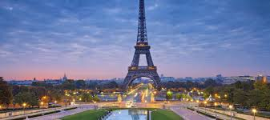
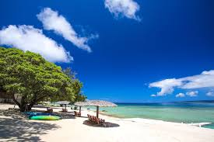
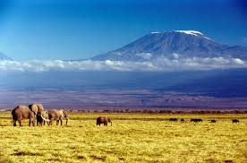
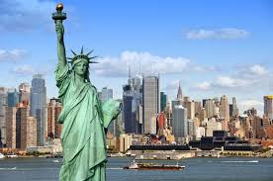
Tourism
The largest economic activity in the world today

Slide 2
Tourism is the largest economic activity in the world today.
There used to be a time when hard-to-reach communities like Îles-de-la-Madeleine and the Island of Tahiti were not touched by the negative effects of tourism.
Nowadays, these places are trying to sustainably develop and plan their space to accommodate the many curious tourists who want to learn more about their cultural and natural heritage.
Who are these tourists?
Where do these tourists go?
How can tourist regions be planned and developed to protect the natural environments and living spaces of their populations?
HOMEWORK page 107 #1-4

Slide 3
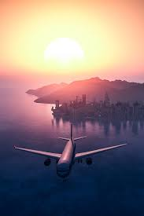
Tourism and Tourist
Tourism grew so much during the 20th century that it is now one of the biggest economic activities in the world.
What factors explain this dramatic growth (what has changed?):
Creation of paid holidays in many industrialized countries,
Higher standard of living for workers
Improved transportation (eg. safer air travel)
Lower cost of train and air travel.

Slide 4
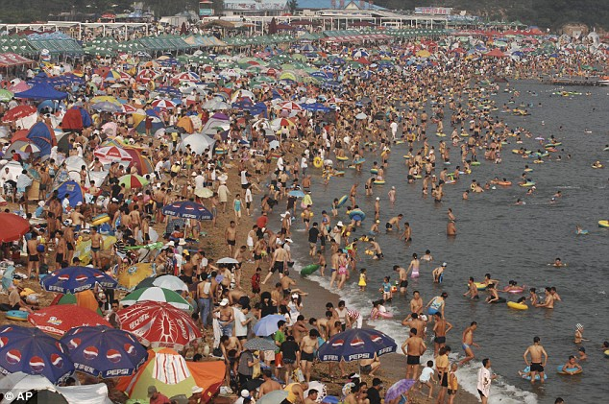
Mass Tourism
All of these factors have led to a growing number of trips and to the growth of mass tourism.
What are the negative impacts of Mass Tourism
Overcrowding of tourist sites
Degradation of natural environments
Overconsumption of resources like water.
Because of the increase in the number of visitors, tourist regions have had to plan and develop their spaces to accommodate all these tourists while preserving their cultural and natural heritage.
Maya Bay
Philippines’ Boracay
Reopening Boracay

Slide 5
What is Tourism?
Tourism also includes all the activities related to the trip, such as visits, accommodation and the purchase of local services and handicrafts.
Tourism therefore includes all the businesses and services available to visitors before, during and after their trip.
Tourism is any type of travelling people do for business or pleasure that is more than 80 km from their home, and that lasts more than 24 hours but less than one year.

Slide 6
Who Are Tourists?
80% of tourists live in industrialized countries.
Most often, they travel within their country of origin or to a neighbouring country.
In 2009, more than half of the world’s 880 million tourists came from Europe.
People from Europe, Japan and the Americas travel more than people from developing countries because they have more money and more holidays. In other words, not everyone on the planet has the same access to tourism.

Slide 7
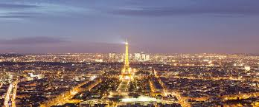
Where Do Tourists Go?
What do you think are the most popular tourist destinations (countries)?
7. United Kingdom
6. Spain
5. USA
4. China
3. Italy
2. Mexcio
1. France
France has remained in first place for many years. This country is popular with tourists not only because of its many cultural, historical and natural attractions, but also because of its geographical location. In fact, France and the other countries that border the Mediterranean Sea make up the largest tourist destination in the world.
Popular Tourist Destinations

Slide 8
Kahoot- Tourist
HOMEWORK Page 110-112 #1-9
Fill in “what I need to remember” sheet
Quiz Thursday 101, Quiz Friday 102

Slide 9
Categories of Tourism
Workbook Page 113
BEACH, MOUNTAIN, CULTURAL, ENTERTAINMENT, ECOTOURISM
Pg 115-116 #1-3

Slide 10
Impacts of Tourism
Which jobs are indirectly associated with tourism?
Farmer
Photographer
Airline workers (pilot, attendant, etc.)
Which jobs are directly associated with Tourism?
Hotel Staff
Park workers
Travel Agents
Promoters
Online Bloggers
In 2010, more than 235 million jobs around the world catered to tourism. The revenue from this industry is enormous. In 2009, international tourism created more than C$874 billion, or around 5% of the world’s total economy
Is Tourism destroying Cities?

Slide 11
How does a tourist region/city, site accommodate more tourists. What needs to be built?
Larger railway stations and airports,
More hotels and other lodging establishments,
More restaurants,
More means of transportation
More parking

Slide 12
Impact on the Environment
Impacts on Natural Environments
In some tourist destinations, the arrival of millions of tourists each year has an unavoidable impact on the natural environment. Some tourist facilities, like huge resorts built by multinationals, can have repercussions for the environment, and increase water, air and visual pollution. The deterioration of the environment then threatens the local flora and fauna and its biodiversity. Overcrowding can also lead to increased water and energy consumption so that, in some cases, the needs of the local population are not met.
Impacts from travel
Bridge and Locks
Paradise Lost

Slide 13
Impact on Locals
Boracay
HOMEWORK: Page 119-121 #1-8
QUIZ TOMORROW!

Slide 14
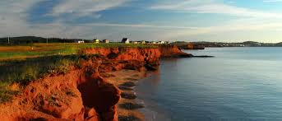
Îles-de-la-Madeleine
Tourism Video
Bucket List
Read page 125-127
Complete #1-2 page 127-128
TOURISM TEST MONDAY

Slide 15
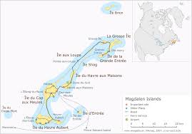
Îles-de-la-Madeleine
Economy
What do you think are the main jobs on the island?
Fishing
Tourism
Health
Education
Mining
Growth of Tourism
Summer
80% from Quebec
62200 visitors in 2012 (20000 in 1977)
Arrive by boat
No public transportation
HOMEWORK
Read page 128-130
Complete #1-5 on page 131

Slide 16
Planning and Developing to Better Accommodate Tourist
New Services
Transportation Network and Infrastructure
Redesign parking lots, washrooms and boardwalks
Accommodations
Cycling Network
Role of the Plants
Protects the dune from wind and waves
Complete #1-2 page 133

Slide 17
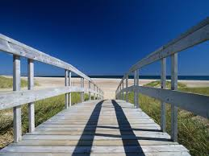
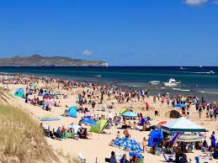
Impacts of Tourism page 134-136
Complete #1-4 page 137-138
Underline the POSITIVE Impacts as we read
Underline the NEGATIVE impacts as we read

Slide 18
REVIEW TEST MONDAY

